Slide 1
CloudBrain-ReconAI: A Cloud Computing Platform for MRI Reconstruction
By – Partha Chowdhari
Dhruv desai
Daksh Girdhar
Department of Computer Engineering
K. J. Somaiya School of Engineering
Somaiya Vidyavihar University

Slide 2
Problem Statement
MRI reconstruction presents challenges including time constraints, image quality concerns, and lack of collaborative tools.
Key Problems:
- Existing solutions lack integration of reconstruction and evaluation.
- Radiologist feedback is often disconnected from engineering workflows.
- Tools like BART or MRIReco.jl require installation and lack support for deep learning and collaboration.

Slide 3
Introduction to MRI & Image Quality Evaluation
MRI is a vital non-invasive imaging technique with applications in neuroscience, oncology, and cardiology.
Quality of Service in MRI includes:
- Speed of reconstruction
- Image clarity
- Artifact suppression
CloudBrain-ReconAI supports these through AI-based reconstruction algorithms and collaborative evaluation tools.

Slide 4
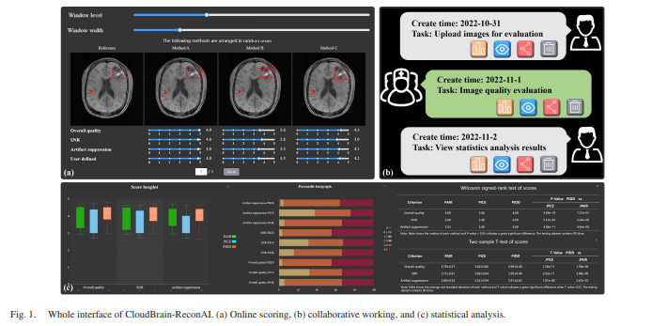

Slide 5
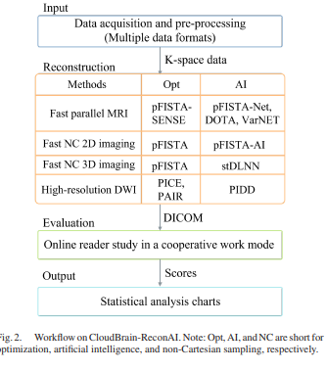

Slide 6
Literature Survey
Traditional methods like BART and MRIReco.jl are powerful but lack deep learning support and user-friendly interfaces.
Recent studies emphasize the need for bio-inspired, hybrid models that integrate robust static methods with adaptive capabilities of algorithms like Ant Colony Optimization for dynamic optimization in reconstruction tasks.

Slide 7
CloudBrain-ReconAI Platform Overview
CloudBrain-ReconAI offers:
- Deployment of optimization and deep learning models for fast and high-resolution MRI.
- Online interface for image scoring and analysis.
- Modular support for Cartesian and non-Cartesian imaging, including diffusion MRI, DCE, and radial sampling.
- Compatibility with ISMRM, DICOM, and .mat formats.

Slide 8
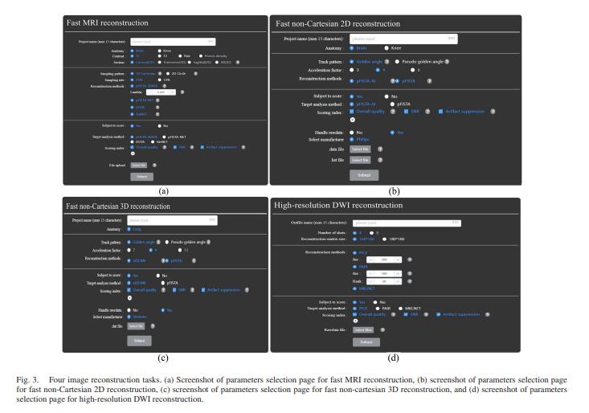

Slide 9
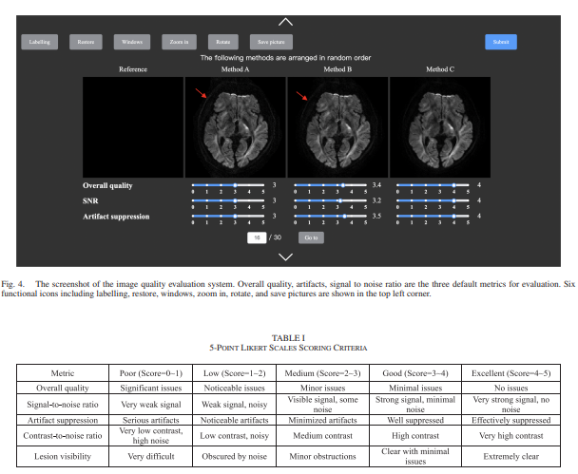

Slide 10
Ant Colony Optimization (ACO) and MRI
Ant Colony Optimization (ACO) simulates the behavior of ants seeking optimal paths, adapted here for resource distribution.
- Ants deposit pheromones to highlight efficient routes, analogous to using performance feedback in task assignment.
- Dynamic and distributed, ACO supports real-time load balancing in complex systems like MRI cloud platforms.

Slide 11
Proposed System Workflow
Workflow includes:
1. Upload MRI k-space data (supports ISMRM Raw, .mat, and DICOM)
2. Select from multiple algorithms
3. Reconstruct and preview images
4. Radiologists annotate and score via browser-based tools
5. System compiles statistical analysis
Automated tools include: ROI marking, slider-based scoring, contrast adjustment, and randomized blind image ordering.

Slide 12
System Architecture
System Architecture:
- Browser-Service-Database model
- Frontend: Vue.js-based GUI
- Backend: Python APIs and microservices
Server Details:
- Master-Slave configuration for load balancing
- Intel Xeon, 128 GB RAM, dual NVIDIA T4 GPUs per server
Data stored in MySQL, Redis (auth tokens), MongoDB (image data)

Slide 13
Research Methodology
Steps include:
1. Define tasks and metrics
2. Collect real and simulated datasets
3. Clean and normalize data
4. Implement baseline (Round Robin)
5. Integrate ACO with monitoring feedback
6. Hybrid orchestration based on system load
7. Statistical evaluation of each strategy's impact on QoS.

Slide 14
Experimental Setup & Results
20 VMs simulated with diverse load patterns and task types (CPU, memory, storage)
Reconstruction tasks included:
- 2D Cartesian (pFISTA, DOTA, VarNET)
- 3D knee (pFISTA-NET)
- Non-Cartesian radial sampling (stDLNN, pFISTA-AI)
- High-res diffusion MRI (PICE, PAIR, PIDD)

Slide 15

Results Analysis
Hybrid Approach:
- 95 ms response
- 80% utilization
- Effective compromise between simplicity and adaptability
Statistical tests (T-test, Wilcoxon) confirm the superiority of hybrid over standalone methods.
Static Load Balancing:
- 120 ms average response
- 70% utilization
ACO (Dynamic):
- 85 ms response
- 90% utilization

Slide 16
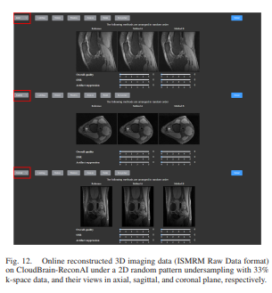
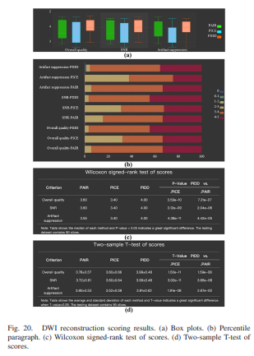

Slide 17
Future Scope
Next steps:
- Integrate with ML for predictive workload management
- Extend to edge computing/IoT scenarios
- Real-world deployment on cloud platforms like AWS/GCP
- Explore energy-aware task scheduling for sustainability

Slide 18
Feasibility Studies
Technical Feasibility:
- Cloud-based system with master-slave architecture ensures high availability.
- Compatible with different MRI data formats including ISMRM, DICOM, .mat.
Operational Feasibility:
- User-friendly browser interface with no setup required.
- Radiologist collaboration enabled through role-based accounts and annotations.
Economic Feasibility:
- Freely accessible platform with potential for academic and clinical adoption.
- Open to integration with hospital PACS systems for future scalability.

Slide 19
Conclusion
CloudBrain-ReconAI represents a significant advancement in collaborative medical imaging tools.
Combining AI and radiologist input, it improves diagnostic efficiency, enhances research productivity, and supports future-ready healthcare AI pipelines.
Fully open-access and designed to scale with research needs.

Slide 20


